Slide 1
Beijing
Normal
University
International Comparative Study on Computational Thinking Educational
in K-12
2019
Yang Xing Jin-bao Zhang
Faculty of Education , College of Educational Technology

Slide 2
CONTENTS
01
Introduction
04
Status of CT In Education
02
Understanding Computa
tional Thinking
05
Summary and Conclusions
03
06
Suggestion and Future
Prospects
Objectives and Relative
Work

Slide 3
Introduction

Slide 4
01
Introduction
Artificial Intelligence
a part of life
Relationship between AI and people
Artificial intelligence
a hot topic
replacement theory
control theory
humanity
People
ideas and methods
the owner of CT
CT education should be given high priority
Notes:
1.Nowadays, the word of "intelligence" has become a part of our life. The wonderful relationship between "artificial intelligence" and "humanity" has always been a hot topic of discussion
2. In order not to be eliminated by the intelligent society

Slide 5
01
Introduction
the goal of CT education
prepare for the opportunities and challenges of the future economy
Regardless of their ultimate field of study or occupation creativity, curiosity and critical thinking
the favor for CT education
the three pillars of politics, economy and education
issue relevant policies
carry out curriculum reforms
CT as an independent discipline
strong economic industries such as Google, Microsoft use their own advantages to create a platform
Notes:
many countries favor the development of CT education
Not only does it own national policy support, the promotion of the economic industry, but also it has theoretical and practical explorations in the field of education

Slide 6
Understanding Computational Thinking

Slide 7
02
Definiton of CT
Papert
1980
Mention fiestly
2006
Wing
problem solving, system design, and human behavior understanding
ISTE&CSTA
2009
problem-solving process
Formulating problems
organizing and analyzing data
representing data through abstraction
algorithmic thinking
the most efficient and effective
Generalizing and transferring
2016
CSTA
abstraction, automation, and analysis
Notes:
1.Computational thinking, a term mentioned by Papert in 1980.
2. defined as a series of thinking activities that cover the breadth of computer science,
3. the K–12 Computer Science Standards. This stresses the problem-solving aspects

Slide 8
02
CT’s relationship with programming
Does programming education equal to CT education?
What’s the deep relationship between programming and CT?
solve real problems
It is difficult to achieve this high requirement only through programming
programming or CS has been or will be introduced into early childhood education
programming
CT
programming plays an important role in the development of CT, it’s only part of it
the method to achieve the control of the computer
tool level
Notes:
programming is the focus of computer science.
Based on the understanding of the running process of computer programs
2.thinking as a computer scientist means more than being able to program a computer

Slide 9
02
CT’s relationship with programming
programming become a tool for learning
programming can make CT concepts more concrete
the process of programming changes the children perspectives from users to creators
express themselves freely
Notes:
Despite these distinctions,

Slide 10
Objectives and related work

Slide 11
03
Objectives and related work
European SchoolNet report
CT definition, integration with curriculum, programming skills assessment, teacher training
Fredrik et al.
ten different countries have approached introducing computing into their K–12 education
A
B
Stefania et al
implications for policy and practice
F
C
Shuchi et al
environment, tools and assessment
Yu-Chang et al.
analyzed Reports, white papers, and policy documents across the global
E
D
Nicol R.
the state’s support for CS program teachers
Notes:
Scoping reviews of the CT education around world the have been conducted in the past but they only focus on the single aspect

Slide 12
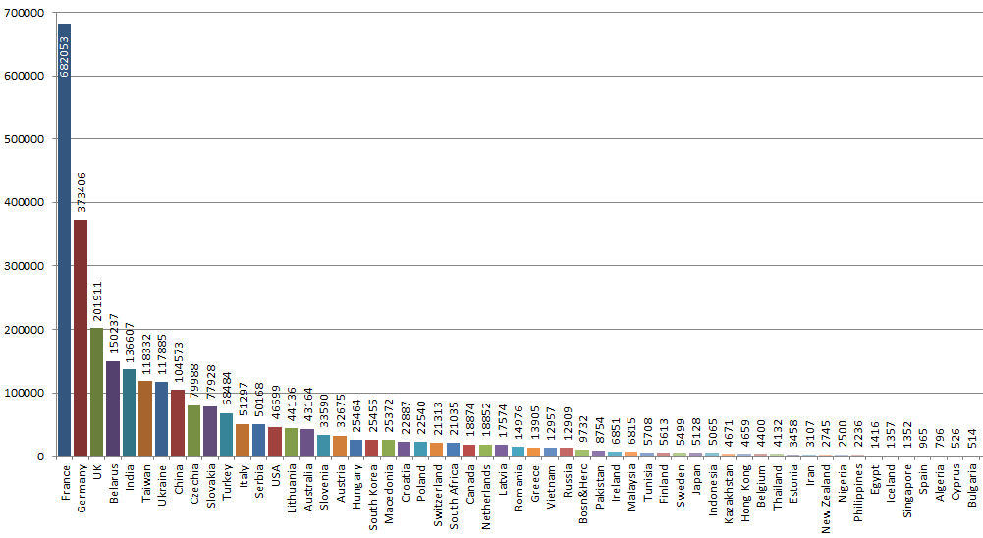
03
Objectives and related work
Lithuania France USA England China
Notes:
1.The statistics of the participants in Bebras Challenge 2018 from countries.
2. the French participants is the most, equaling to dozens of times of other countries

Slide 13
03
Objectives and related work
exploring the status of CT in K-12 education from different countries
exploring why the studied countries develop the CT perfectly
preparing ideas for collaboration and partnerships to introduce and enhance CT education
constructing the general development framework for CT education

Slide 14
Status of CT In Education

Slide 15
04
Status of CT In Education
Computing tools and assessment
Policy making
Organizational support
1
2
3
4
5
6
Role in primary and secondary level curriculum
Teacher training
Economic industry promotion

Slide 16
04
Status of CT In Education
In China, CT education research is still in its infancy:
don’t have a background in CS
not familiar with the basic concepts of CS
there isn’t a clear curriculum system
difficult to combine CT with the courses currently taught
What and how to teach
assessment
other
IT
Notes:
it is found that CT education research is still in its infancy. 80% of the research involves CS courses in higher education, and K-12 researches focus on the information technology curriculum, lacking interdisciplinary integration education

Slide 17
04
China
CS-college
IT-elementary
decontextualized and considered irrelevant
2007，College Computers course reform by integrating CT into the curriculum
2017, CT was regarded as one of the core literacy of information technology disciplines.
China
l
digital literacy, creative ability, and computational thinking
compulsory, elective, and optional compulsory subjects,
AI, 3D design, open source hardware,
database, information system
he new college entrance examination reform program：IT course in the seven-choice three subjects
Scratch and App Inventor
Notes:
1.it is not an assessment subject for important exams (such as college entrance examinations
2. exam-oriented education
3.浙江改革：It is the first time that information technology is recognized as the assessment subject in the key examinations

Slide 18
04
USA
A
the control of education primarily depends on the state and local government， the status of CS may vary significantly across the states.—“CS for all”
B
Businesses：Apple, Facebook, Microsoft and Code.org
organizations including ACM, CSTA, Code.org, CIC, and NMSI---“five percepts and seven practices”：
What should be taught and what the children can do after graduation?
How to carry out CS education in early childhood?
How to plan a course to ensure the effective connection of compulsory and secondary education?
How to assess the development of CT?
C
high school students have the option of taking electives in technology or, in some places, taking the Advanced Placement Computer Science course which is currently a Java programming class；
teaching tools ：Alice, AgentSheet, Blockly, Kodu and Scratch；
Teachers --primary teacher certification in some discipline other than computer science and then meet additional requirements to receive a supplemental computer science endorsement
Notes:
1.5概念7实践can use the framework to inform the development of standards and curriculum, build capacity for teaching computer science and implement computer science pathways
2.Policy there are also some meaures
2. provides them with credit

Slide 19
04
England
October 2012
February 2013
the government sets out plans to boost the teaching of computer science, supported by industry experts such as Microsoft, Facebook, BT
the Ministry of Education announced that the new curriculum, computing;
develop computational thinking
main aims of computing course
Janary 2013
understand and apply the fundamental principles and concepts of computer science;
analyze problems in computational terms;;
evaluate and apply information technology;
responsible, competent, confident and creative users of ICT
the government announced that it was included in the EBacc exam

Slide 20
04
England
CAS (Computing at school) community established, supported financially by BCS, Microsoft, Google, Ensoft and the UK Committee of Heads and Professors of Computer Science
Unlike an organizer, CAS is more like a public platform
CAS provides instructional programs and instructional syllabus for each stage
The teachers can take part in the teacher training of CAS, who satisfy the required credit can get a certification of BCS
executes a project to improve girls’ participation
Notes:
1、world-class computing education
2. teachers and experts can share their understanding of computing courses, interact what difficulties they encounter during student performance, improve the structure of the curriculum, and improve the quality of teaching.

Slide 21
04
Lithuania
"informatics" --"Information Technology“
satisfy students’ need and foster computer literacy
the first ideas to establish a school to teach programming
1980s
2005
1970-1975
1997
The first few after-school classes in programming
Education Reform
two years to four years
application and the processing of information
Notes:
1.CS is referred to as informatics
2.1997：went through a major revision
3。with more focus on application and the processing of information

Slide 22
04
Lithuania
Methodology
strong and well designed by Lithuanian's researchers
Teachers: IT subject is taught by IT teachers who have various types of training
Courses
grades 5-10, 1 hour per week.
information; digital technologies; algorithms and programming; virtual communication; security, ethics and legal principles
grade 11-12, elective subject offered in basic and advanced modes
electronic publishing, database design and management, and programming
exams and contests
curriculum of Informatics exam : algorithms, data types and structures, and constructs of a programming language
Bebras Challenge, Olympiads in Informatics
Notes:
The curriculum of Informatics exam closely corresponds to the content of the programming module

Slide 23
04
France
Students’ learning in ISN must be assessed during an oral presentation of the outcomes
In the 1980’s, a new elective course, to promote the algorithmic way of thinking
teachers from scientific subject matter (mathematics, physics and chemistry) trained by Superior Schools of Teaching and Education-SSTE
MoE: the curriculum covering programming, unplugged activities is established
in 2012, algorithmic was introduced in mathematics curricula at grade 11 and an elective Computer Science course (called ISN) at grade 12
in 2016, Class’Code is a consortium of universities, companies and the government, offering educators free online CT courses and resources as well as face-to-face meetings
Notes:
appointed by the MoE

Slide 24
Summary and Conclusions

Slide 25
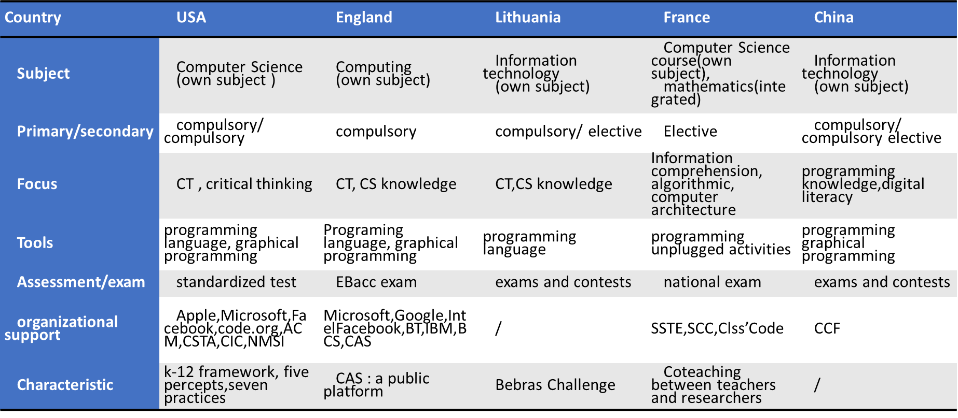
05
Summary and Conclusions
Notes:
Different countries have different institutional settings according to their own development，we summarize in the chart.
The visible hand of "policy" and the invisible hand of "industry" form a huge educational circle to promote the development of CT education jointly

Slide 26
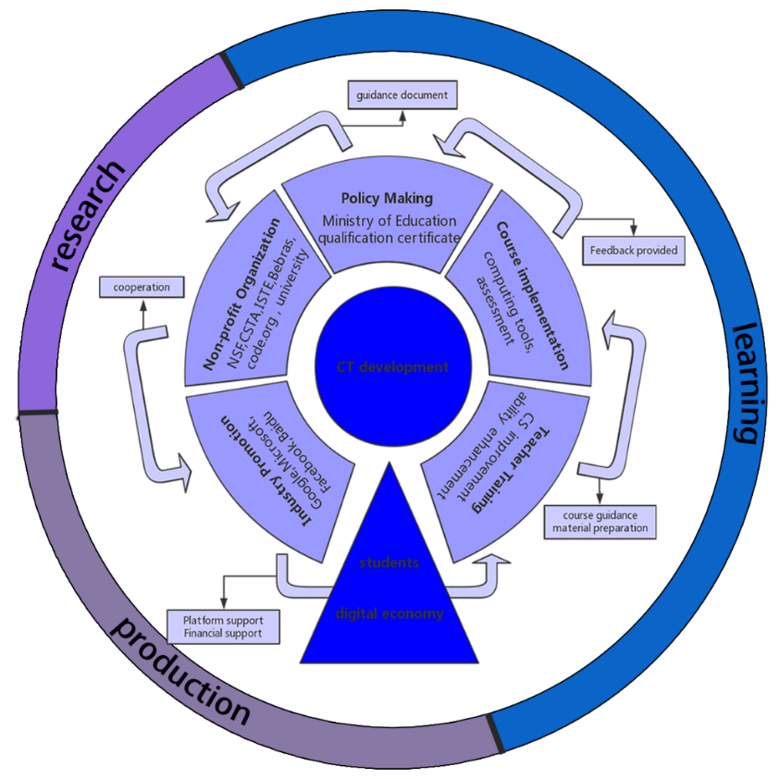
06
Summary and Conclusions
as a tree
five parts: policy making, non-profit organization, industry promotion, teacher training, course implementation
three parts: production, learning, and research
the root of the tree represents the needs of
Notes:
1.provide a general framework of CT education across the globe
2.we describe the framework as a tree, the branches represent the frame dimensions, consisting of five parts: policy making, non-profit organization, industry promotion, teacher training, course implementation
3. related to each other and echoes each other to form a large whole

Slide 27
06
Summary and Conclusions
Policy making
Teacher training
Industry promotion
Nonprofit
Organization
Course implementation
Guidance document bring together a variety of stakeholders
charges for the certificate qualification of the teachers
share ideas and experiences
provide course guidance and material for teachers
build a relationship of cooperation
build platform and provide financial support for the teacher training.
Exercise thinking and learn something new here.
give feedback to policy makers,practitioners and researchers.
Notes:
In a word, the implementation of perfect education needs efforts from multiple departments.

Slide 28
Suggestion and Future Prospects

Slide 29
06
Suggestion and Future Prospects
With the development of transportation, the members of the Ministry of education can visit the CT related course in other countries by themselves. The course implementation can give feedback to the policy making. They can interact with the teachers and students to get first-hand information. As experts of education, their suggestion to the improvement of the course plan is also valuable for the teachers.
With the developed Internet, the teachers from each country can take part in a public community where they can share the experience of their native curriculum and resolve the questions for each other.
The industry promotion plays a great role in development. The industries like Google may provide financial support or teaching material for the teacher training. They can record the process of the training as videos so that many people can get access to the resource through MOOC. The role of the industries can also be an intermediary to combine the countries together.

Slide 30
Beijing
Normal
University
2019 Cyprus
Thanks for your attention!
2019
Learning as a teacher , acting as a model

