Slide 1
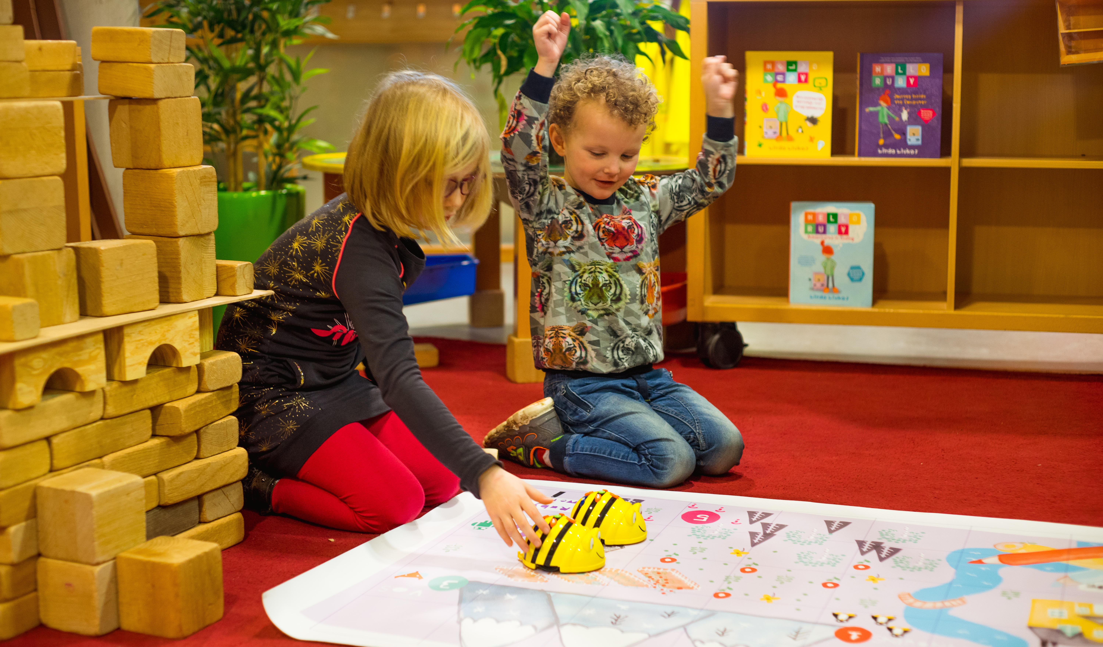
Observing Abstraction with Cubetto
Josina Koning & Hylke Faber
School of Education, Hanze University of Applied Sciences

Slide 2
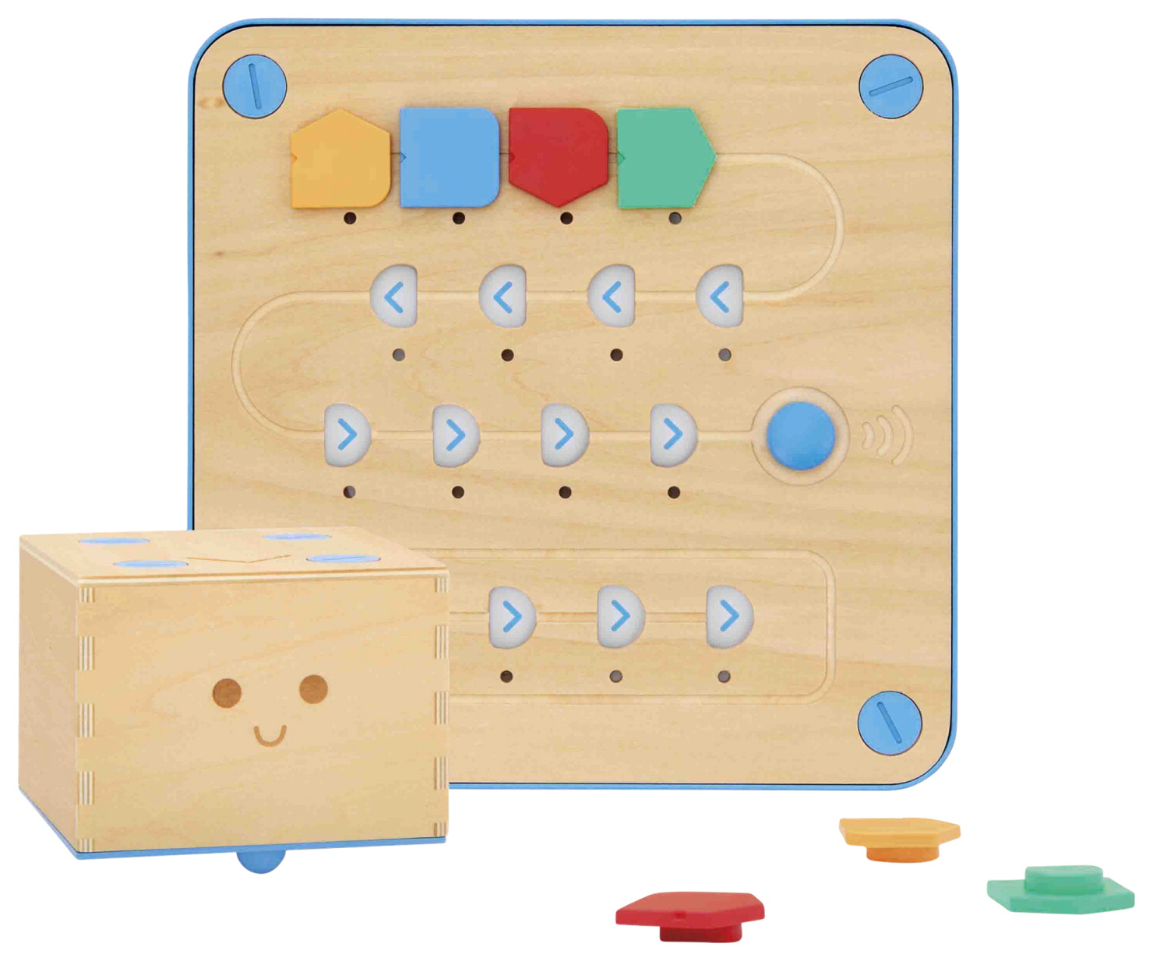
Overview
Theoretical Background
Method
Results
Analysis
Discussion

Slide 3
Research project
Context of this paper
Understand, and make use of, the capabilities of digital technology
Allowing children to participate in digital society
How can we, as a teacher-trainers, contribute?

Slide 4
Research project
Context of this paper
👶
👦
👨
Child
(Student) Teacher
Teacher-trainer

Slide 5
Research project
Context of this paper
Goal: teaching computational thinking
Focus: abstraction
👶
👦
👨
Child
(Student) Teacher
Teacher-trainer

Slide 6
Research question
How can abstraction be operationalized to characterize behavior of 5 to 6 year old students tasked with programming an algorithmic task?

Slide 7
Research question
QUALITATIVE STUDY
How can abstraction be operationalized to characterize behavior of 5 to 6 year old students tasked with programming an algorithmic task?

Slide 8
Theoretical background
Layers of Abstraction
Educational Design
Early childhood programming

Slide 9
Layers of Abstraction
Perrenet et al, 2005
Problem
Design (object level)
Code (program level)
Execution

Slide 10
Layers of Abstraction
Perrenet et al, 2005
Operationalization in primary education with children?
Operationalization in context of programming Cubetto?

Slide 11
Educational Design
Computational Complexity (Kalas et al, 2018)
Dimension of Control
Dimension of Representation
Cubetto offers more computational representation than Beebot

Slide 12
Early childhood programming
Koning et al, 2017
Tell a story from Hello Ruby book (by Linda Liukas, 2015)
Help Cubetto reach Ruby’s friends
Collect gems when you succesfully program Cubetto

Slide 13
Method
Research group
Moderately sized primary school (400 students)
CT not part of curriculum
2nd grade
17 students, 8 boys and 9 girls
Mean age 5 years and 5 months
Licensed primary school teacher
Video and audio recordings

Slide 14
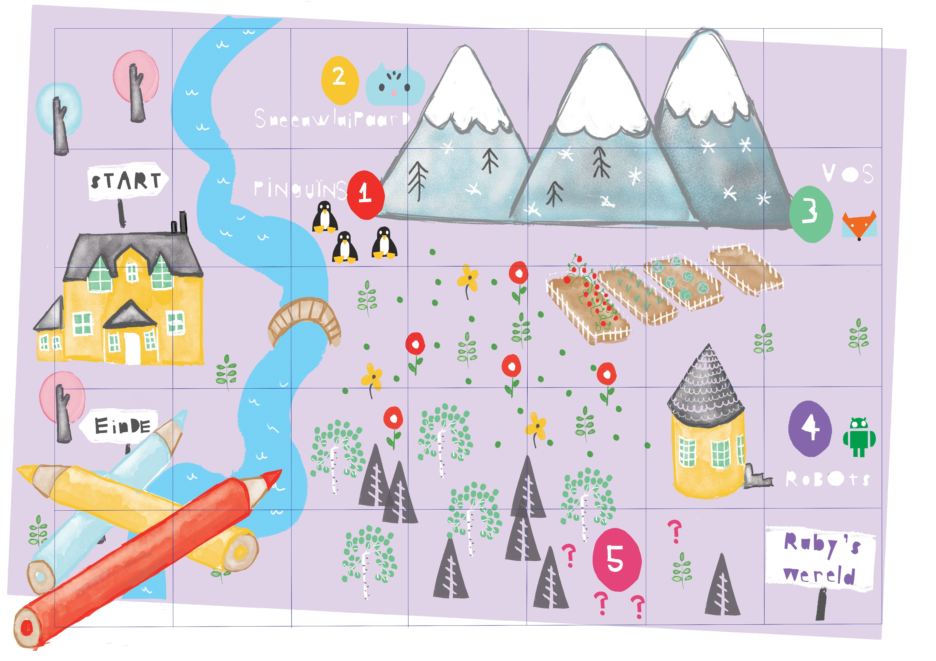
Educational design
Complexity and required programming effort increases with every assignment
Teacher was instructed to limit the support towards the students

Slide 15
Data analysis
Prototype observation schema
Independent analysis
Categorize behavior
Refine schema
Pattern analysis
Analyze videos with definitive observation schema
1
2
3
4
Initial analysis
Definitions of LoA
Sample behavior
Definitive observation schema
Calculate inter-rater reliability
(Cohen's kappa = 0,74 substantial agreement

Slide 16
Results
Operationalization of the model
Layer definition
Problem layer: | behavior related to understanding the task
Design layer: | behavior related to designing a route for Cubetto, describing it in human language without using coding blocks
Code layer | behavior related to translating the designed route into a sequence of coding blocks
Execution layer | Behavior related to the outcome of the translated code

Slide 17
Results
Video student 12

Slide 18
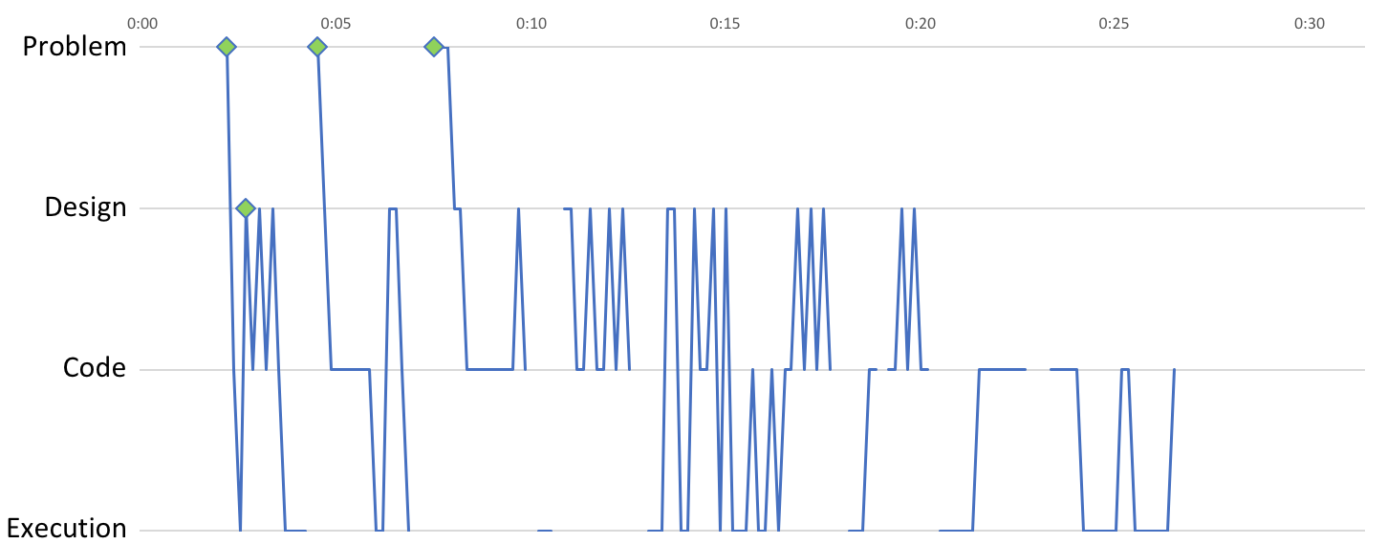
Results
Pattern analysis

Slide 19
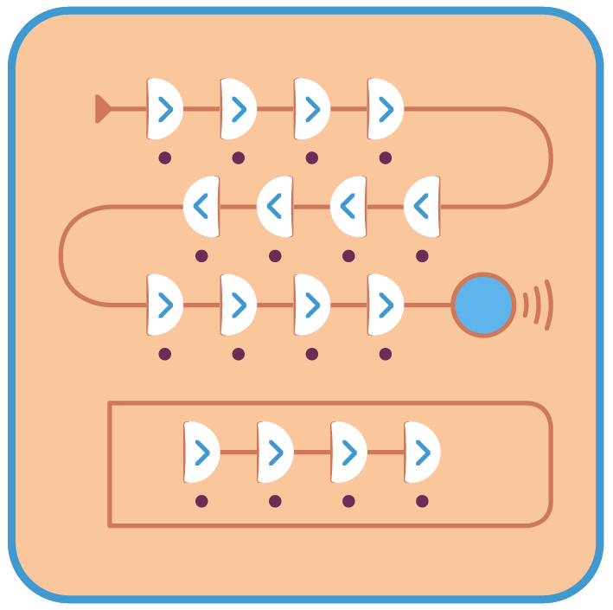
Discussion
Cubetto
Difficulties placing coding blocks
Shape and layout remote control board
More time in code layer than expected?

Slide 20
Discussion
Layers of abstraction
Distinction between design layer and code layer
Considered split in design layer: abstract and concrete
Debugging or trial-and-error?

Slide 21
Conclusion
Succeeded to characterize abstraction in young students’ behavior and demonstrated how to use layers of abstraction model to operationalize abstraction
Insight on how students engage in the process of abstraction over time and what patterns emerge during that time

Slide 22
Future research
How can teachers use LOA model to guide their support?

Slide 23
Thank you!
Any questions?
Josina Koning: j.i.koning@pl.hanze.nl
Hylke Faber: h.h.faber@pl.hanze.nl

