Slide 1

CONFERENCE PLATFORM

Slide 2
The ECVP 2023 conference will be accompanied by a “Conference Platform” This platform will function as a gateway for viewing the conference program.
During the conference, ALL sessions can be accessed by logging in to the Conference Platform at www.easyacademia.org.
The Conference Platform can be accessed with the same credentials used to submit your paper.
The participants who have submitted already have a username and a password to login - make sure you have those available.
The role will be given based on your registration email. If you have submitted a paper with a different email, please make sure to add the second email to your EasyAcademia account (Account Details – Email Addresses).

Slide 3
If you have not used the “EasyAcademia” submission system before, please use the guidelines below to create an account.
HOW TO CREATE AN ACCOUNT
First, you will need to set up an account.
Go to www.easyacademia.org and click on the “Get Started” button.
Note: In case you have already submitted an abstract to ECVP 2023, you already have an account.

Slide 4
This link will bring up a signup page:
Follow the on-screen instructions and complete the form and click on “Create Account”.
IMPORTANT: The account should be created with the email used during your registration for the conference at www.easyconferences.org.
You will then receive an email with the activation code, and you should use the link provided in the email to verify your account.
Note:
▪ Please check your Spam folder if you have not received the email within a few minutes.
▪ If your email appears taken, it is possible that you have signed up for Easy Academia in the past for another conference. In this case, you simply need to ask the system to remind you of your password based on your email.

Slide 5
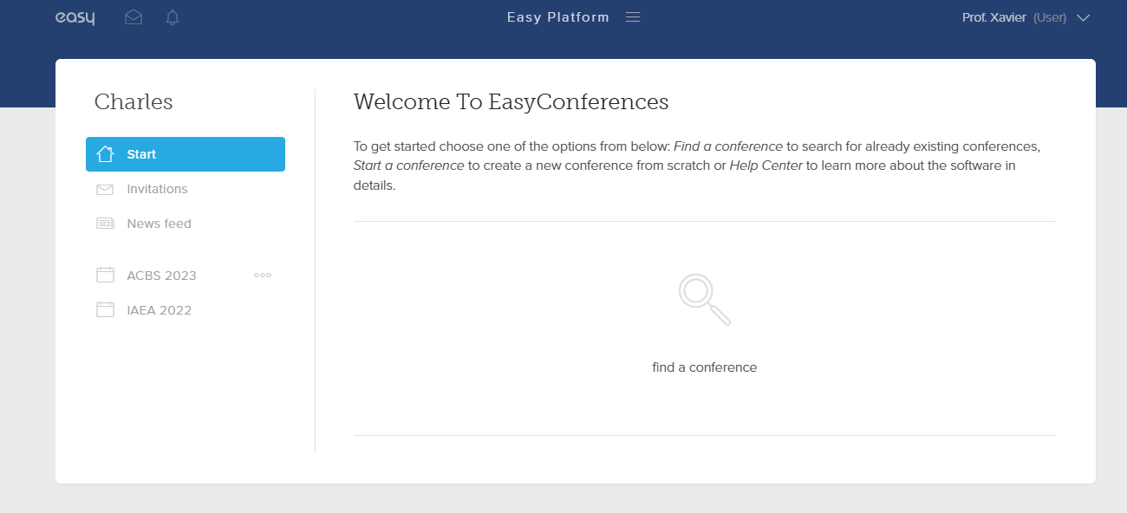
THE EASYCONFERENCES WELCOME PAGE
When you log in you will be taken to the EasyConferences Welcome page.
On this page, please select the “ECVP 2023” conference from left column to move to the ECVP 2023 Conference Platform.
If the “ECVP 2023” conference does not appear as a choice, please contact us at info@easyconferences.eu

Slide 6
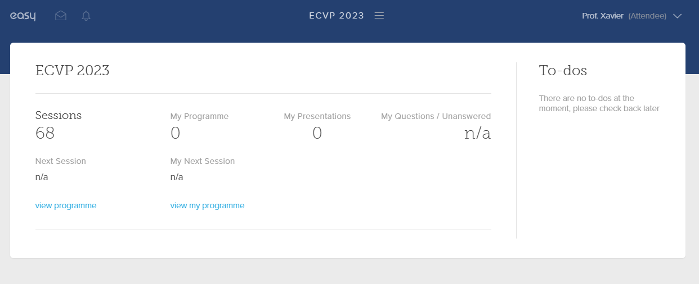
The ECVP 2023 CONFERENCE PLATFORM DASHBOARD
Once you select ECVP 2023, you will be directed to the conference platform’s dashboard.
Notes:
The platform recognizes all the roles you have assumed since the submission process. If you have submitted, the platform will know you as an “Author” as well. Make sure that you have selected the role of “Attendee” on the top right corner (if it is not already selected select it from the dropdown menu)
“View Programme” directs you to the conference program and links
“View my Programme” directs you to the sessions you favorited (details in the following slides)

Slide 7
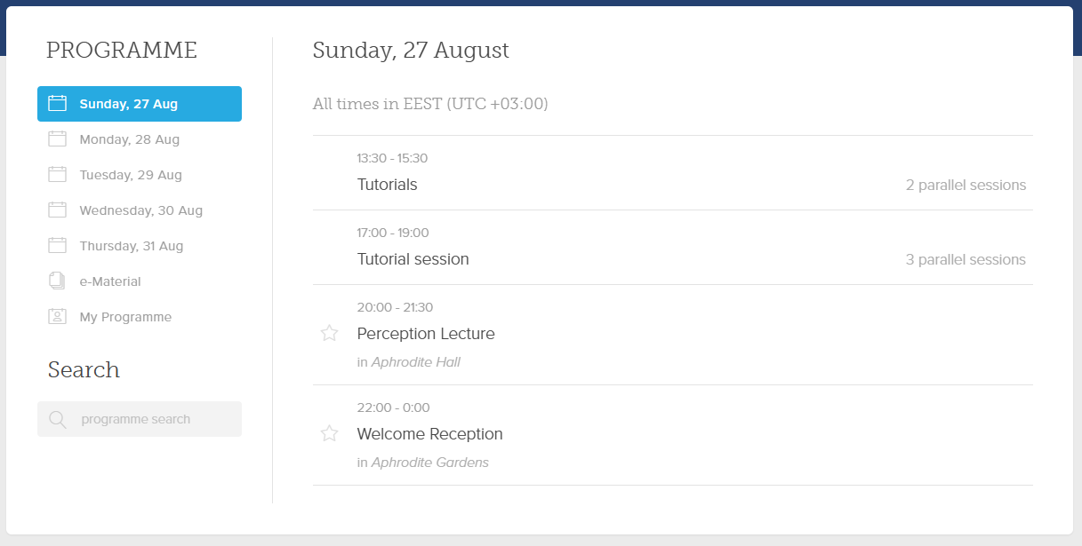
THE CONFERENCE PROGRAMME
The programme, by day, is available to navigate once you click on “View Programme”
The column on the left allows you to go through the conference days, view sessions and presentation details
“My Programme” will include the favorited sessions (The ones you mark with a star)

Slide 8
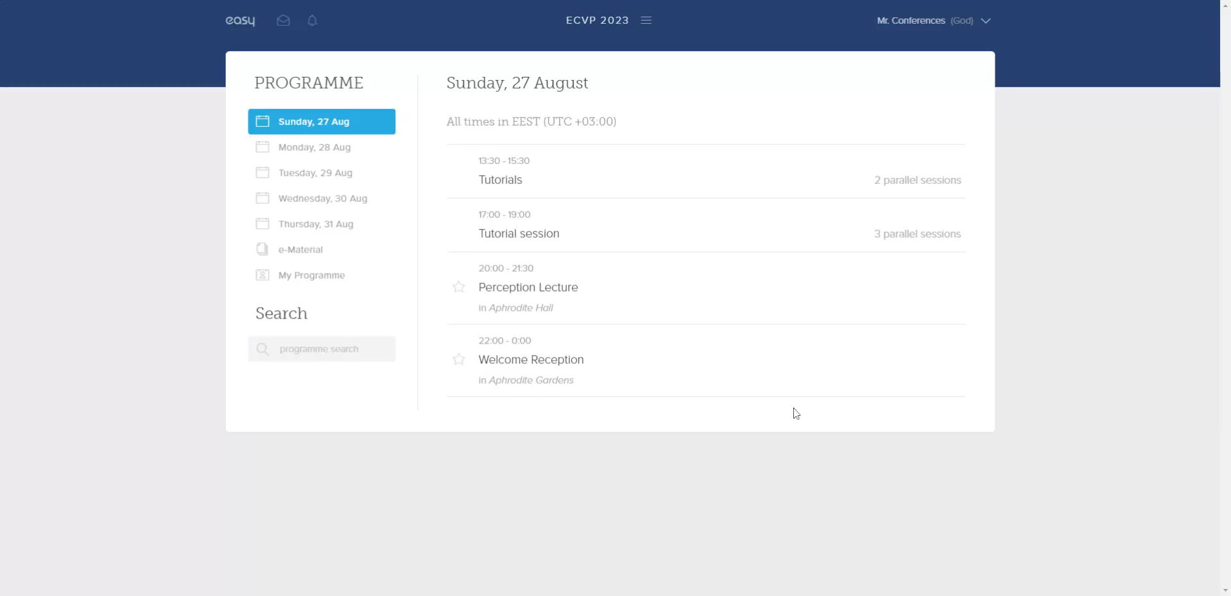
ACCESSING EACH PRESENTATION’S PAGE
You can access each individual presentation by clicking on the title while you are in the corresponding session page.
Each presentation page contains the information of the submitted, the scheduling details as well as access to the asynchronous communication with the presenter of the submission (the Join Discussion button)
The “Join Discussion” allows you to address questions in writing to the authors who will respond, in time, through the platform.
View video above

Slide 9
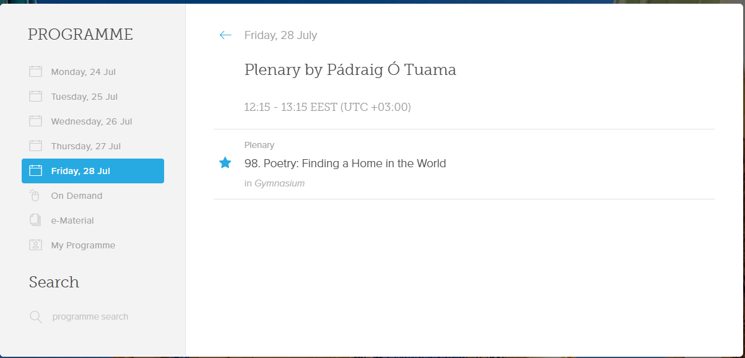
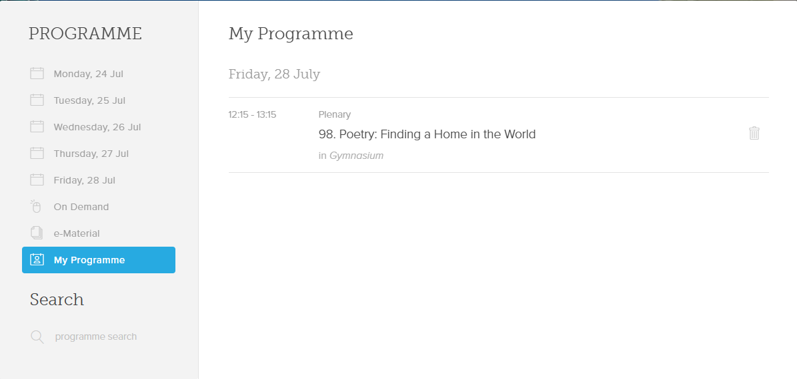
USING THE “My Programme” FUNCTION
By adding a star next to each session, you place it to “My Programme”
You will then have a list of the presentations you have selected for immediate access to their pages.

